Slide 1
INTERFACES
LECTURE 7

Slide 2

Definition
An interface is basically a kind of class. Like classes, interfaces contain methods and variables but with a major difference.
interfaces define only abstract methods and final fields.

Slide 3
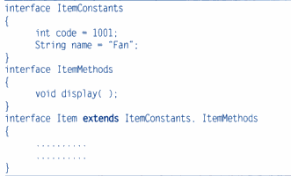
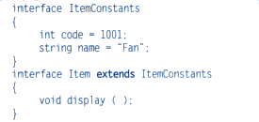
Extending interface
Like classes, interfaces can also be extended.
The new subinterface will inherit all the members of the superinterface in the manner similar to subclasses.

Slide 4


Implementing interfaces
Interfaces are used as superclasses whose properties are inherited by classes.
General syntax :

Slide 5
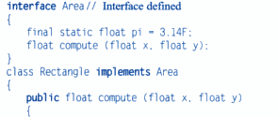
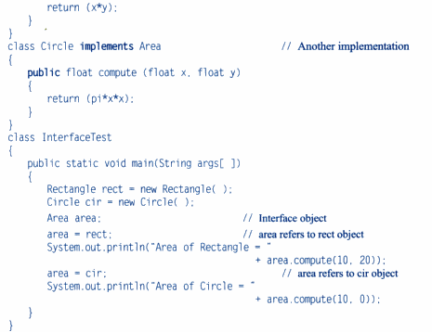

Slide 6
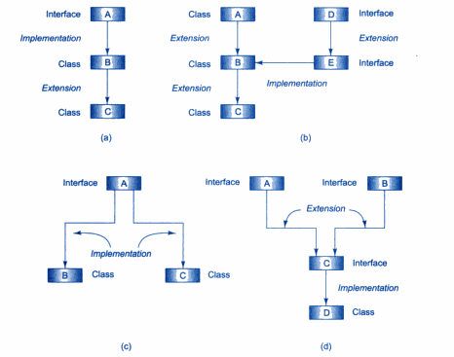
Forms of interface implementation

Slide 7
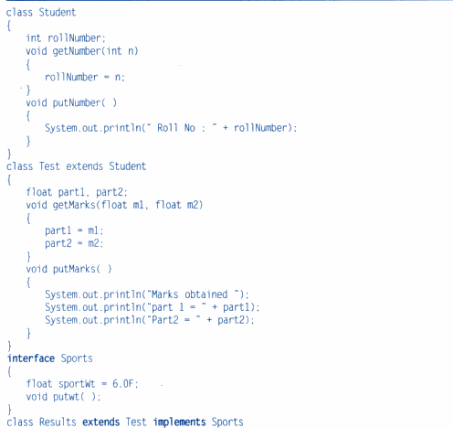
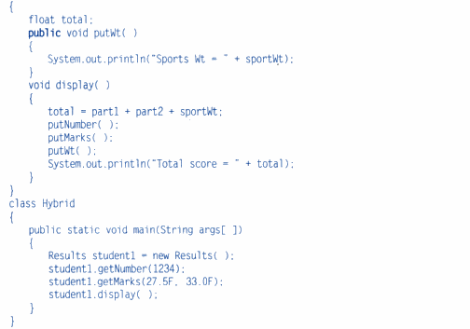
multiple inheritance

